Slide 1
Deep Generative Models
CSCI 4360/6360 Data Science II

Slide 2
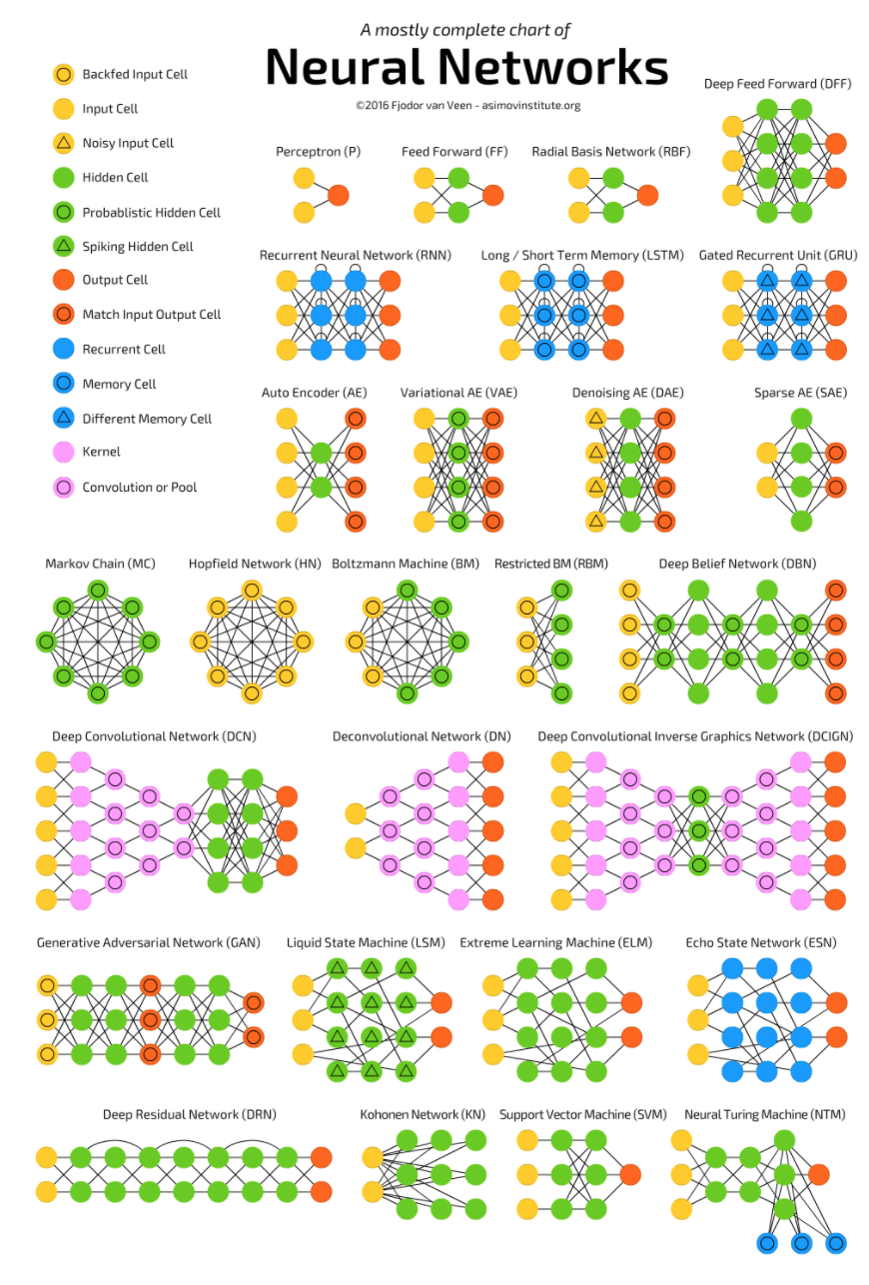
The Neural Network Zoo
http://www.asimovinstitute.org/neural-network-zoo/

Slide 3
The Neural Network Zoo
http://www.asimovinstitute.org/neural-network-zoo/
Last week

Slide 4
The Neural Network Zoo
http://www.asimovinstitute.org/neural-network-zoo/
Tuesday

Slide 5
The Neural Network Zoo
http://www.asimovinstitute.org/neural-network-zoo/
Today

Slide 6
What is a “generative model”?
Discriminative
Logistic Regression
Support Vector Machines
Random Forests
Generative
Gaussian Naïve Bayes
Variational Autoencoders
Adversarial Networks
P(Y | X)
P(X, Y) and P(Y)

Slide 7
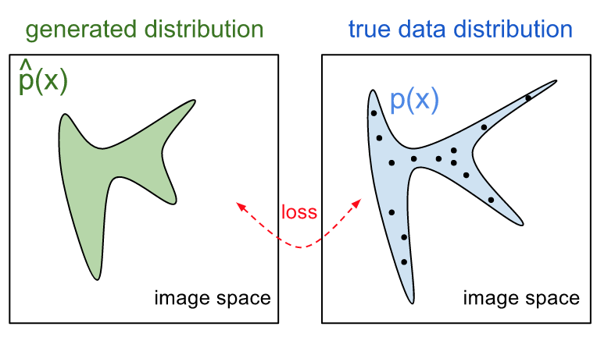
Generative Models

Slide 8
Generative Models

Slide 9
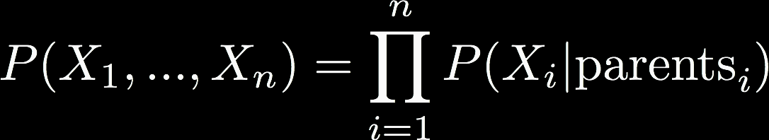
Probabilistic Graphical Models
Arrows represent conditional dependencies between random variables
Structure is used in generative models
Latent generating distribution (hidden)
Observed variables (influenced by latent vars)

Slide 10
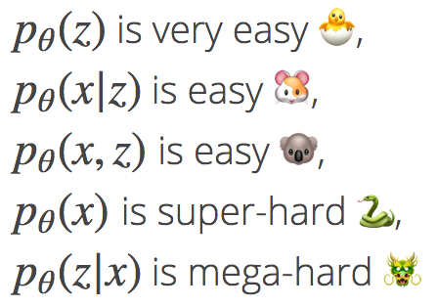
Variational Inference
What is variational inference?
Good for learning latent variable models (i.e., generating distributions of data)
For each observation x we assign a hidden variable z; our model p describes the joint distribution between x and z
Of course these are the things we want to calculate
Inference is p(z|x)
Learning involves p(x)

Slide 11
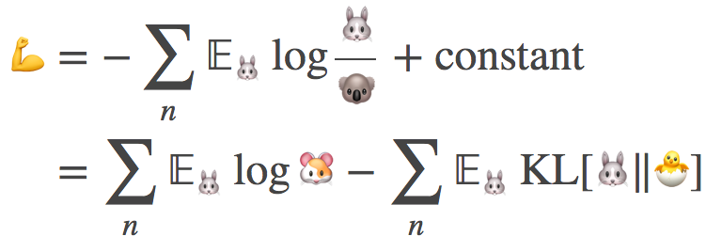
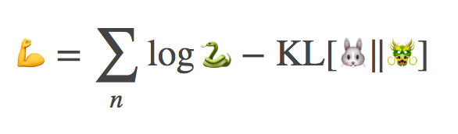
Variational Inference
Rather than learning p(z|x) directly, variational inference approximates with q(z|x)
Maximize the evidence lower bound (ELBO)
This can be written in terms of the “friendly” emojis

Slide 12
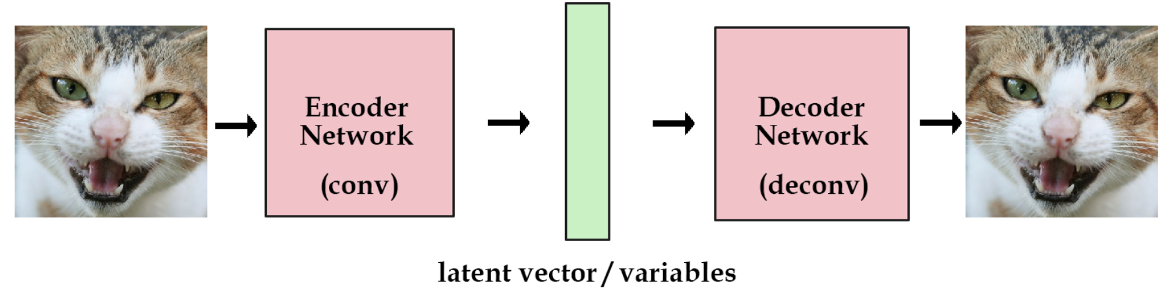
Recall: Autoencoders

Slide 13
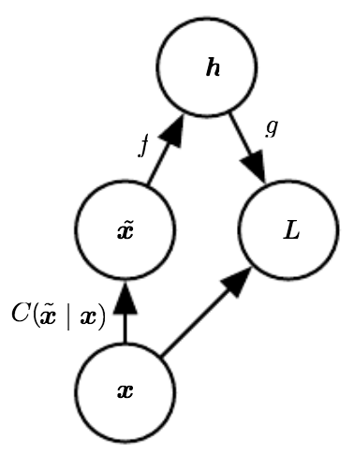

Denoising Autoencoders
Define a corruption process, C
Autoencoder learns a reconstruction distribution $p_{reconstruct}\left(x \right|\tilde{x})$
Sample a training example x
Sample a corrupted version $\tilde{x}$ from C
Use $(x,\tilde{x})$ as a training pair

Slide 14
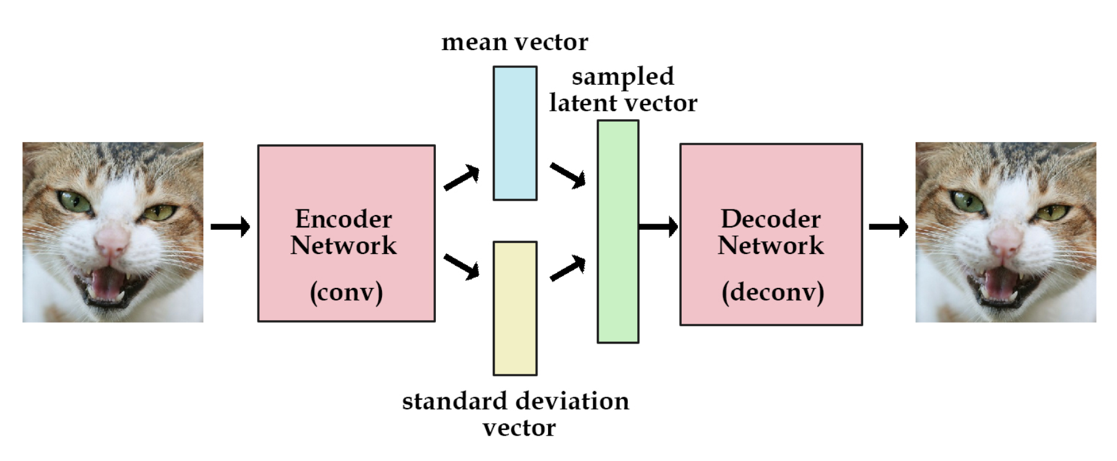
Denoising Autoencoders
De-corruption process results in learning a distribution

Slide 15
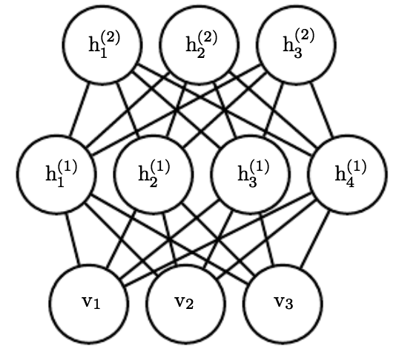
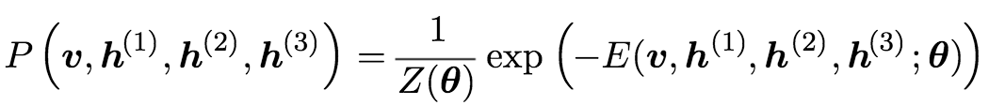
Restricted Boltzmann Machines (RBMs)
Wholly undirected deep network
Implementation of a probabilistic graphical model
Each variable conditionally independent given neighboring nodes
Parameterized by energy function
Sampling from deep RBMs is hard, but training is paradoxically easy

Slide 16
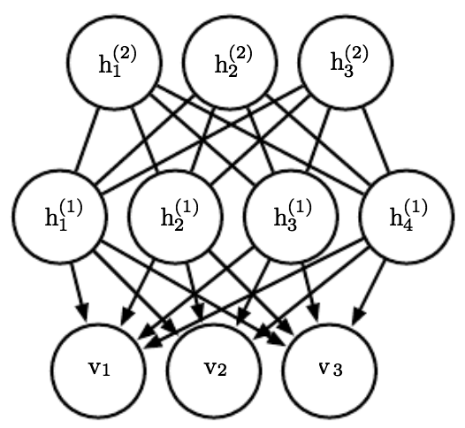
Deep Belief Nets (DBNs)
Connections between layers, but not units within a layer
Arguably one of the first successful applications of modern deep learning
Hinton 2006 and 2007
Often built from an RBM template
Training is nearly intractable
Posterior has to be approximated through annealed importance sampling (AIS)

Slide 17
Generative Adversarial Networks (GANs)

Slide 18
GANs
Game-theoretic approach to generative modeling
Two deep networks: a generator (G) and discriminator (D)

Slide 19
GANs
Generator
Input: a random vector z
Output: something as close to a “real” data point as possible
Discriminator
Input: a ”real” data point OR a synthetic example from G
Output: 1 or 0 (real or fake)

Slide 20
GANs
Minimax “game”
Generator and Discriminator have competing objectives
Goal is to find an equilibrium point
Maximize the Discriminator’s likelihood of identifying a real data example
Minimize the Discriminator’s ability to differentiate real data from Generator examplars

Slide 21
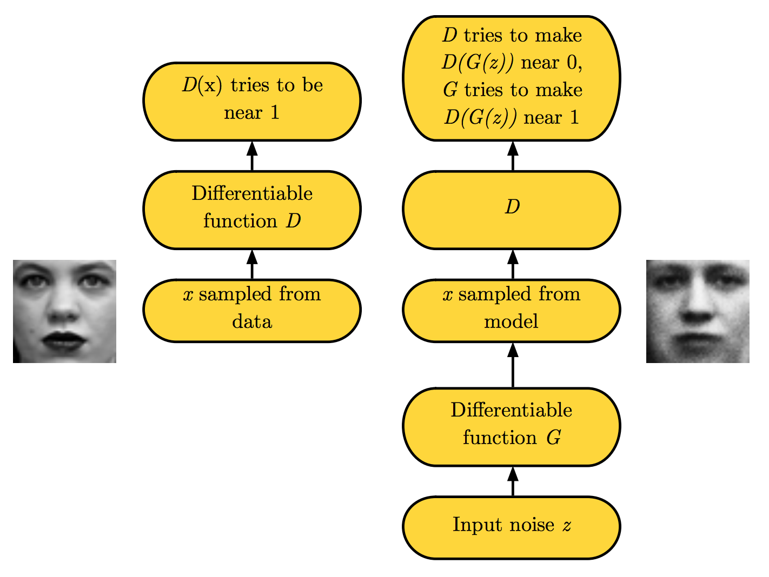
GANs

Slide 22
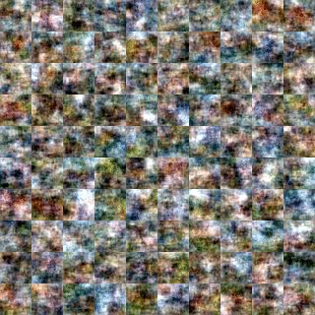
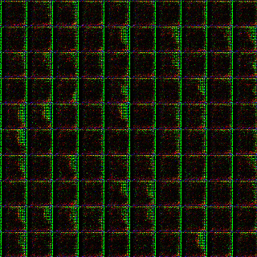
VAEs versus GANs
VAEs
Expectation over learned distribution results in blurring
GANs
Samples from learned distribution, resulting in sharper images

Slide 23
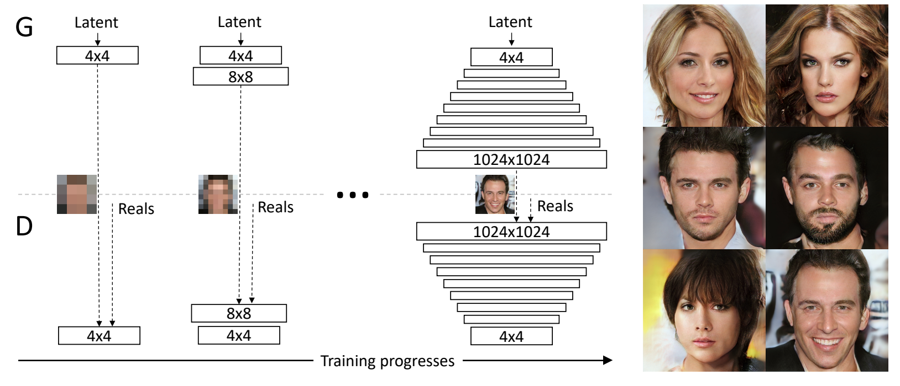
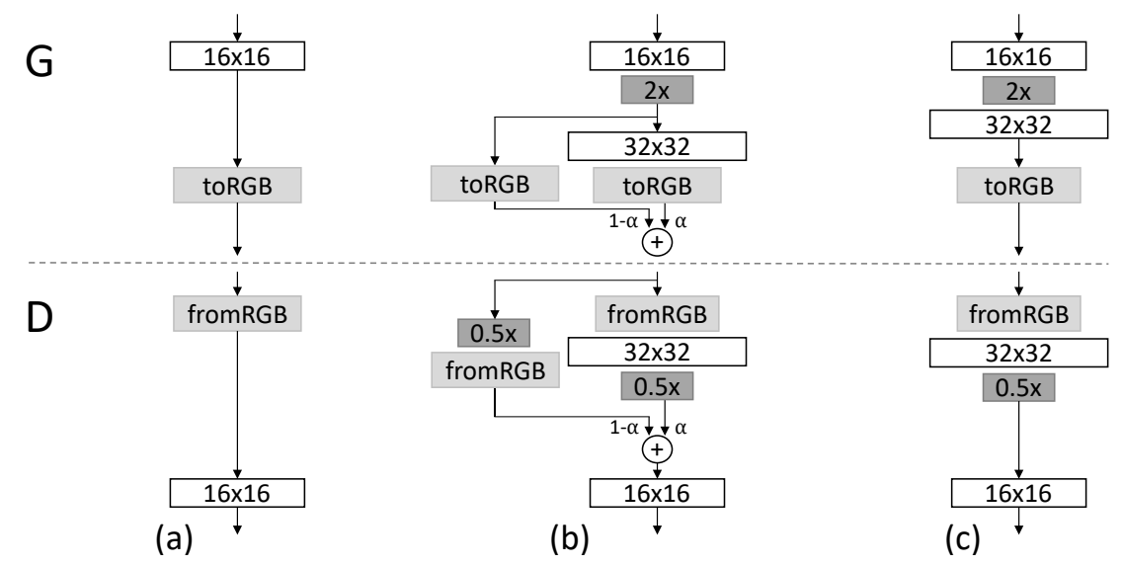
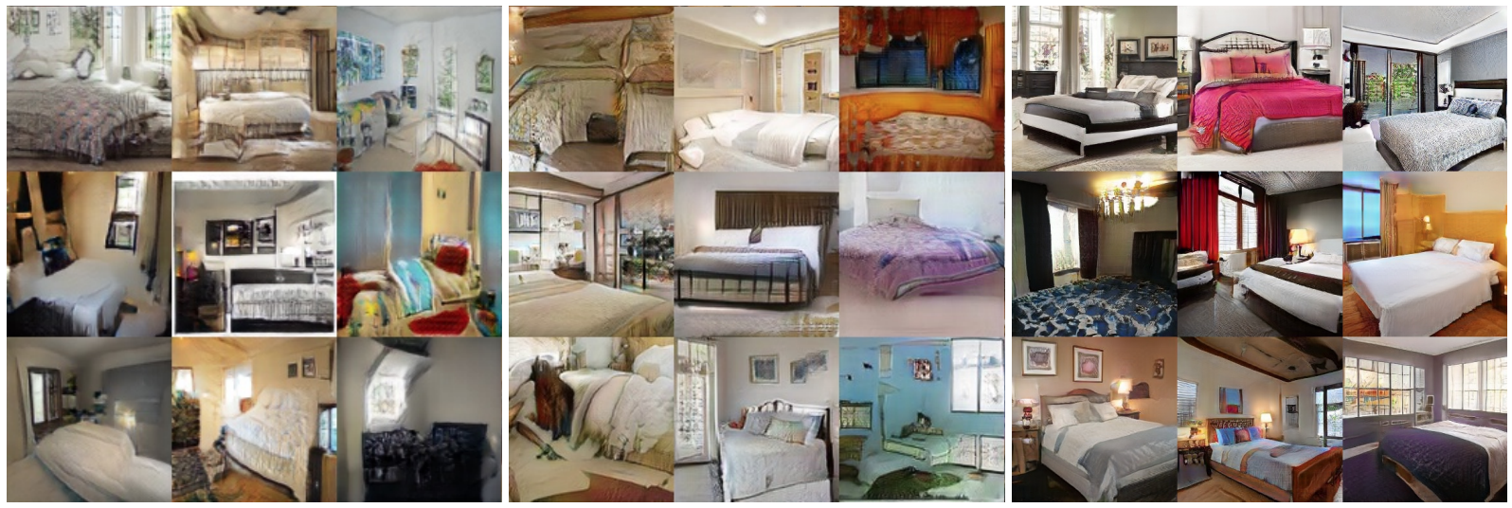
GAN Advances
Progressively grow the GAN subspace over training
Notes:
All generated images!
Treat images from previous training rounds as residuals

Slide 24
GAN Advances
Wasserstein objective function
“Earth-mover” distance W(q, p)
Minimum cost of transporting mass in order to transform distribution q into the distribution p (where cost is mass x distance)
Gradient is much better behaved than Jenson-Shannon objective (KL-divergence based)
Weights are clipped at [-c, c]
Takes a lot longer to train on average
Notes:
Capacity is still heavily restricted from what it should be
Problems with vanishing and exploding gradients during training due to weight clipping

Slide 25
GAN Advances
Improved Wasserstein
Introduces a gradient penalty on the discriminator output with respect to its input
Instead of hard clipping gradient weights, soft[max] penalties are used
P_{r} is the distribution of real data, P_{g} is from the generator, and P_{x} is defined from sampling uniformly along straight lines between pairs of points sampled from P_{r} and P_{g}
Original** WGAN objective
Two-sided gradient penalty on Discriminator
Notes:
This is motivated by the fact that the graph of the optimal critic consists of straight lines connecting points from Pr and Pg.
Given that enforcing the unit gradient norm constraint everywhere is intractable, enforcing it only along these straight lines seems sufficient and experimentally results in good performance

Slide 26
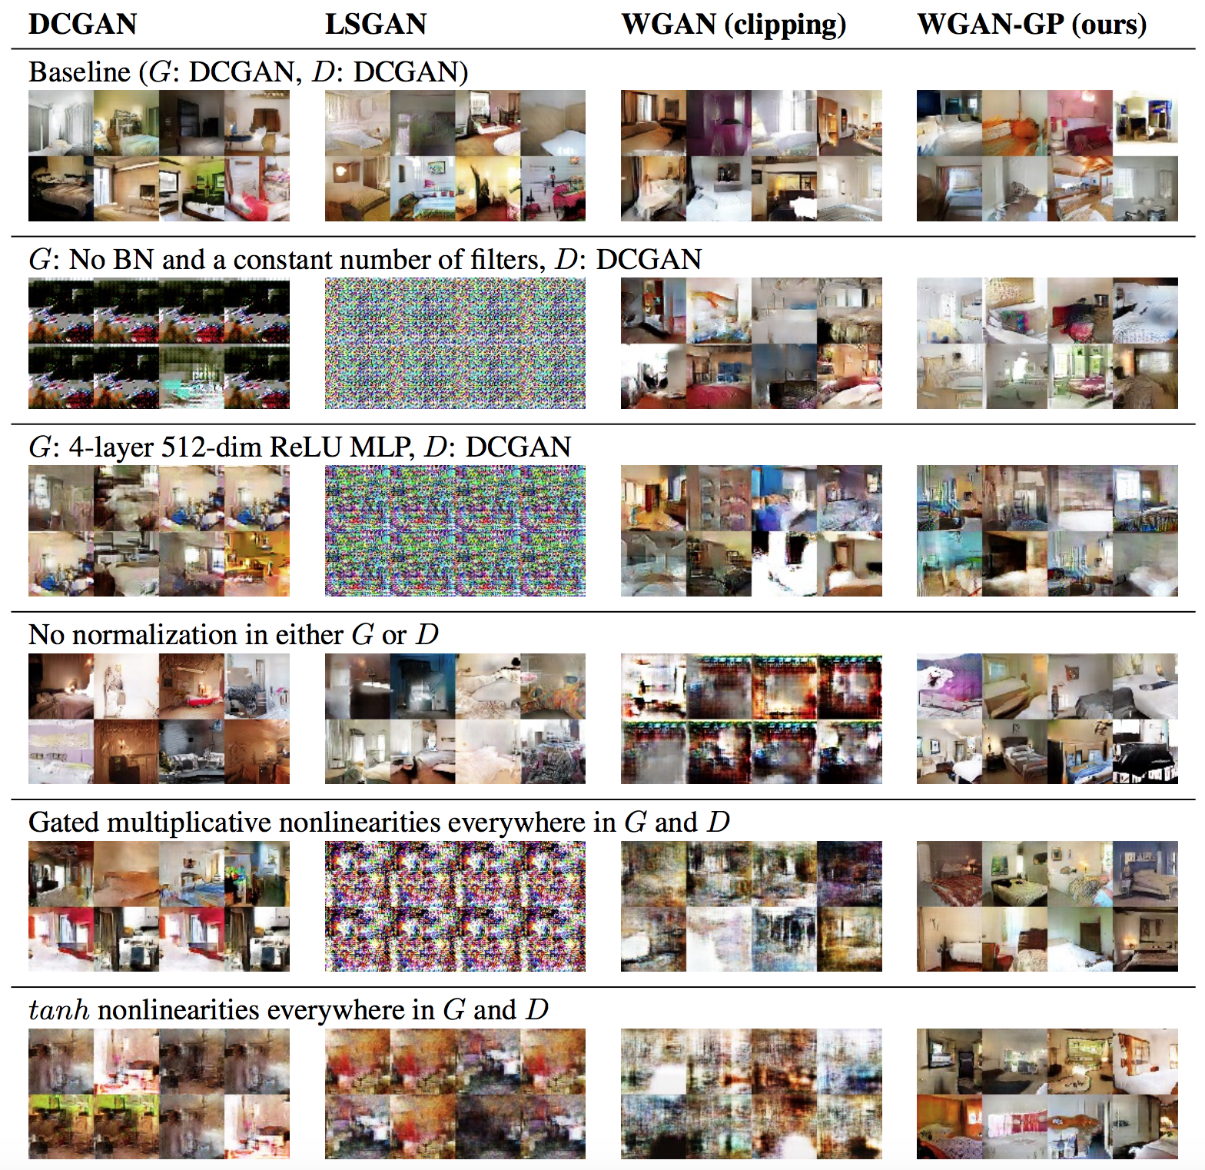

Slide 27
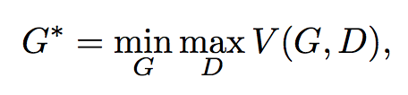
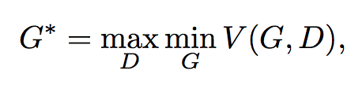
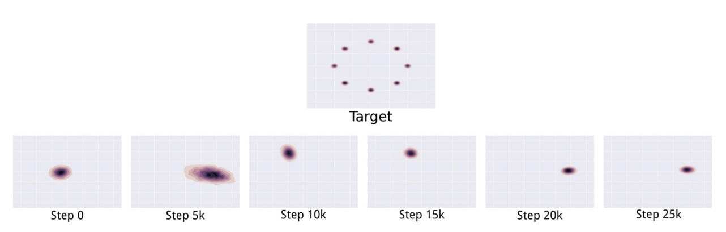
Open Questions with GANs
Mode collapse
The “Helvetica Scenario”
Maps several different inputs z to the same output
Full collapse is rare, but partial collapse is common
Notes:
the minimization with respect to the generator now lies in the inner loop of the optimization procedure. The generator is thus asked to map every z value to the single x coordinate that the discriminator believes is most likely to be real rather than fake. Simultaneous gradient descent does not clearly privilege min max over max min or vice versa. We use it in the hope that it will behave like min max but it often behaves like max min.
Does not seem to be caused by any particular loss function

Slide 28
Open Questions with GANs
Evaluation of GANs
(not specific to GANs per se, but generative models)
Models that obtain good likelihoods can generate bad samples
Models that generate good samples can have poor likelihoods
Also difficult to evaluate likelihood with GANs

Slide 29
Open Questions with GANs
Goal is to find Nash equilibrium
Problem 1: Does it exist?
No conclusive way to show this
Problem 2: If it exists, can we find it?
Inability to find equilibrium can be cause of oscillatory behavior in training
…or a sign that equilibrium doesn’t exist?
Problem 3: More than finding equilibrium, can generator win?
Intuitively: to learn as representative a generator as possible, discriminator should be utterly unable to differentiate between real and fake

Slide 30
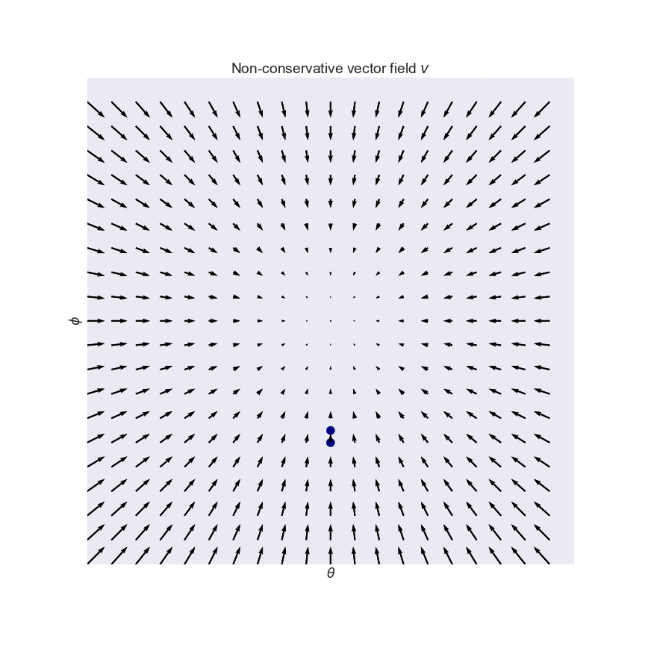
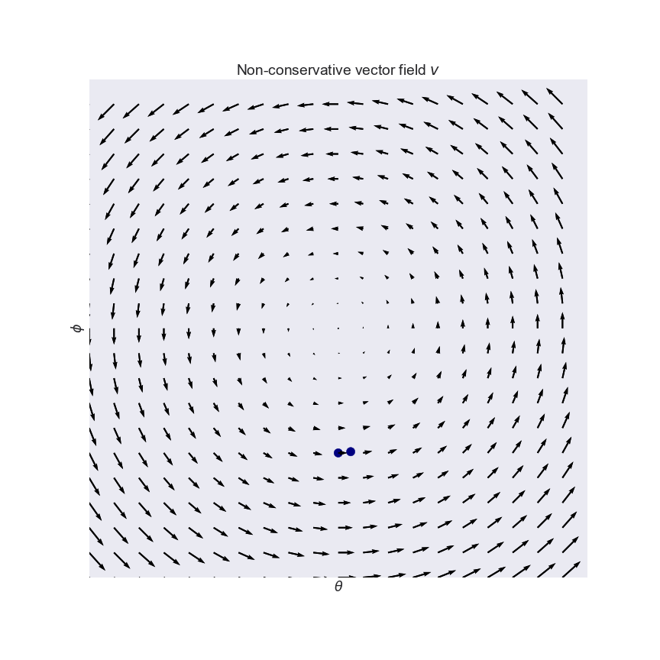
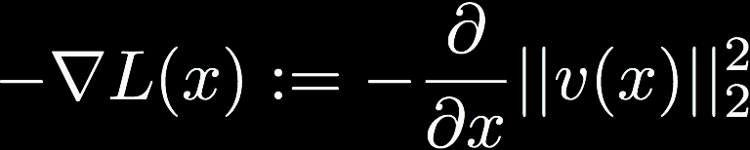
Training a GAN
GANs use a variant of SGD called simultaneous gradient descent
Key difference: the latter gives rise to non-conservative vector fields
Like Escher’s staircase
Solution: convert to conservative vector field
New problem: can’t differentiate between saddle points or equilibria, or negative or positive equilibria

Slide 31
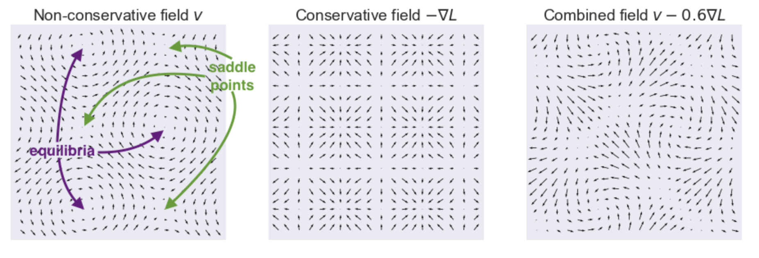
Training a GAN
Notes:
On the left-hand plot I annotated equilibria and saddle points.
The middle plot shows the conservative relaxation −∇L−∇L where both saddle points and equilibria are turned to local minima.
So what can we do? We can simply take a linear combination of the original vv and it's conservative cousin −∇L−∇L. This is what the combined (still non-conservative) vector field looks like for the curl field (see also the third panel of the figure above):

Slide 32
Open Questions with GANs
Exploration of the learned manifold
Advantage of GANs: no a priori assumptions on the underlying form of the generating distribution
Disadvantage of GANs: no way to meaningfully interpret the resulting learned generating distribution
Manifold walking, interpolation, image algebra, INFO-GANs

Slide 33
Conclusions
Generative modeling
Learn a distribution instead of a decision boundary
Can still be used for classification
Usually requires more data than discriminative models
Deep generative modeling
Denoising & Variational Autoencoders
Deep Belief Networks
Restricted Boltzmann Machines
Generative Adversarial Networks (GANs)
Game-theoretic generative modeling through dueling deep networks
Attempt to find Nash equilibrium
Many numerical and algorithmic limitations but results are impressive

Slide 34
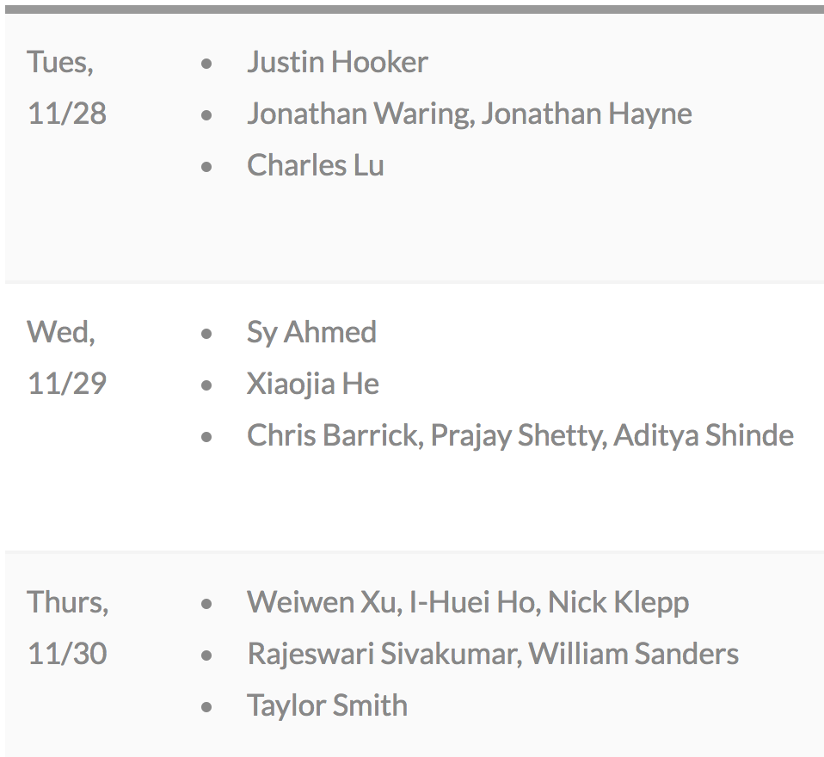
Course Details
All project slots taken!

Slide 35
References
“Generative Learning algorithms”, CS 229 notes by Andrew Ng http://cs229.stanford.edu/notes/cs229-notes2.pdf
Andrew Ng and Michael I. Jordan (!!!), “On Discriminative vs. Generative classifiers: A comparison of logistic regression and naive Bayes” (NIPS 2002) http://papers.nips.cc/paper/2020-on-discriminative-vs-generative-classifiers-a-comparison-of-logistic-regression-and-naive-bayes.pdf
“Generative versus Discriminative”, Cross-Validated https://stats.stackexchange.com/questions/12421/generative-vs-discriminative/223850
“Generative Adversarial Networks”, NIPS 2016 Tutorial https://arxiv.org/pdf/1701.00160.pdf
Variational Inference http://www.inference.vc/choice-of-recognition-models-in-vaes-a-regularisation-view/
Tutorial on Variational Autoencoders https://arxiv.org/abs/1606.05908
“Progressive Growing of GANs for Improved Quality, Stability, and Variation”, https://arxiv.org/abs/1710.10196
“Generative Adversarial Networks (GANs), Some Open Questions”, http://www.offconvex.org/2017/03/15/GANs/
“GANs are Broken in More than One Way: The Numerics of GANs”, http://www.inference.vc/my-notes-on-the-numerics-of-gans/

